Slide 1
A Fuzzy Logic Model of the Romanian Uninominal Proportional Elections System
Horia F. Pop
Department of Computer Science
Babeş-Bolyai University
Cluj-Napoca

Slide 2
Claims
Election laws should be written by mathematicians, not by politicians
Algorithms should be used with care
(i.e. Greedy is not a universal panacea)
Elections is a fuzzy logic problem
Dr. Horia F. Pop, Fuzzy Elections

Slide 3
Contents
Elections law
  Overview and peculiarities
  Example, Counterexample
The Greedy algorithm
Fuzzy logic
  Insight
  Definitions
Defuzzification of fuzzy partitions
  Definitions
  Methods
  Issues
The future
Dr. Horia F. Pop, Fuzzy Elections

Slide 4
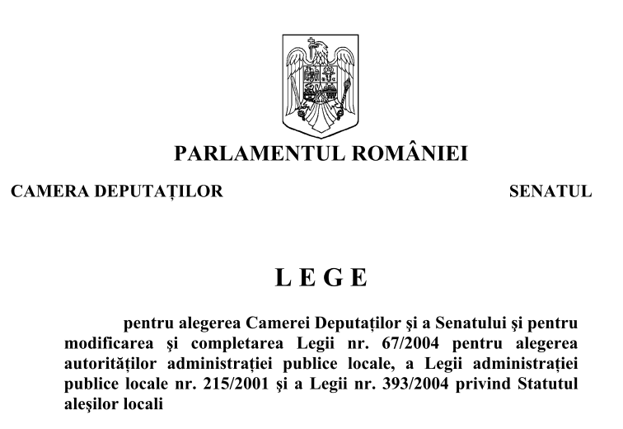
Romanian Elections Act
No. 15/2008 (Art. 47, 48)
Dr. Horia F. Pop, Fuzzy Elections

Slide 5
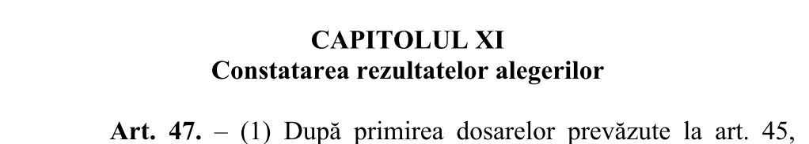
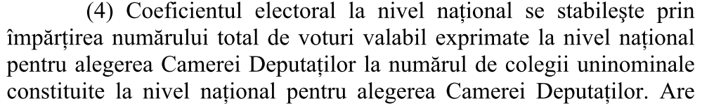
Electoral coefficient (national)
Dr. Horia F. Pop, Fuzzy Elections
Notes:
Dr. Horia F. Pop, Fuzzy Elections

Slide 6
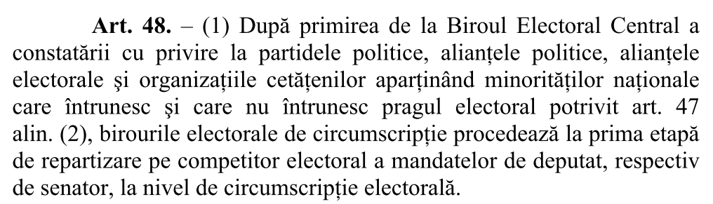
Dr. Horia F. Pop, Fuzzy Elections

Slide 7
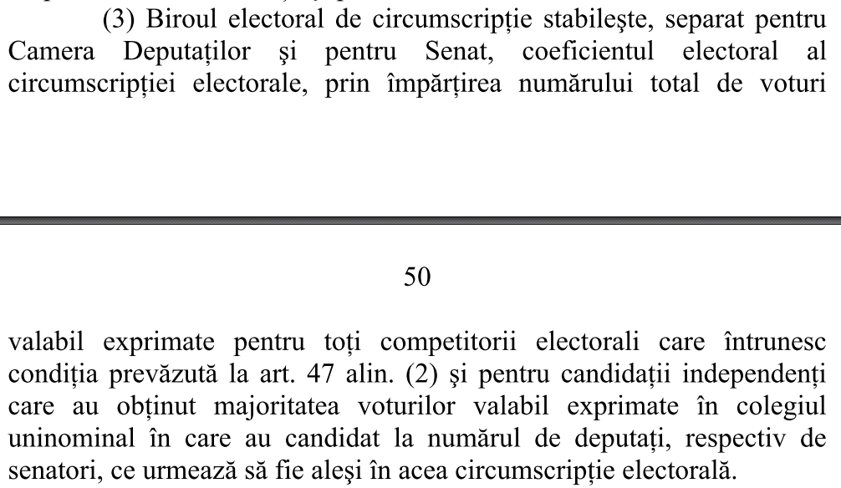
Electoral coefficient (county)
Dr. Horia F. Pop, Fuzzy Elections

Slide 8
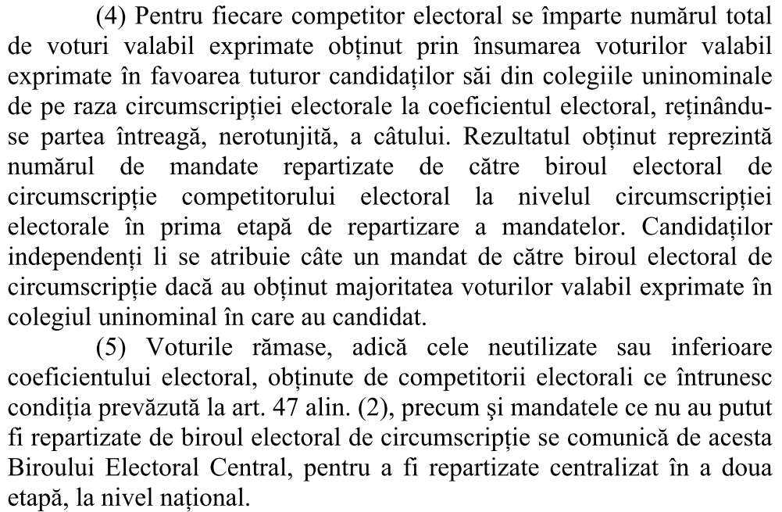
Mandates allocation / county
(step 1)
Dr. Horia F. Pop, Fuzzy Elections

Slide 9
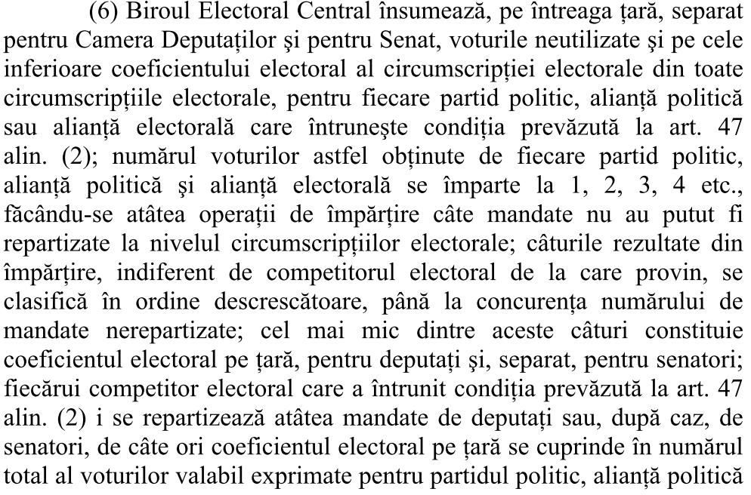
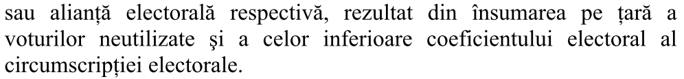
Mandates allocation / national
(step 2)
Dr. Horia F. Pop, Fuzzy Elections

Slide 10
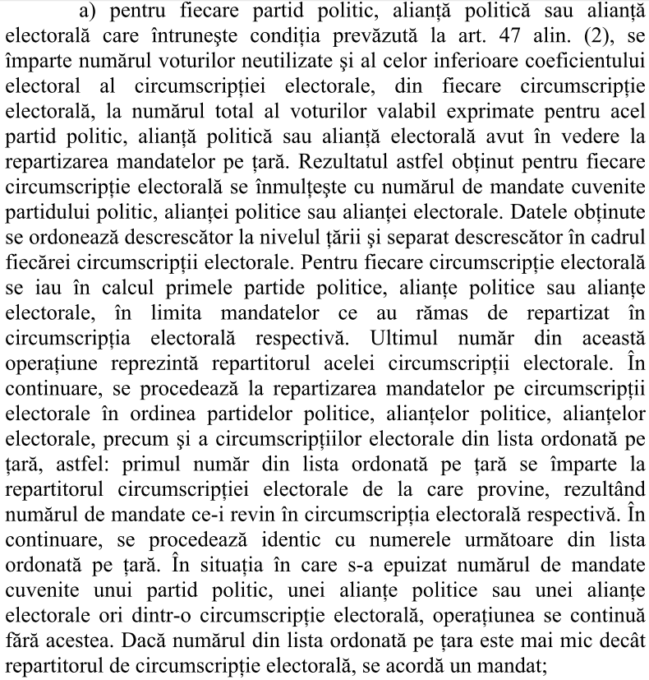
Mandates allocation / county
(step 3)
Dr. Horia F. Pop, Fuzzy Elections

Slide 11
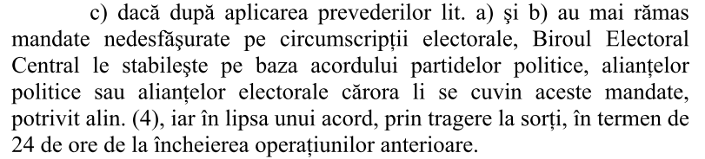
Mandates allocated by political negotiation or by random choice
Dr. Horia F. Pop, Fuzzy Elections

Slide 12
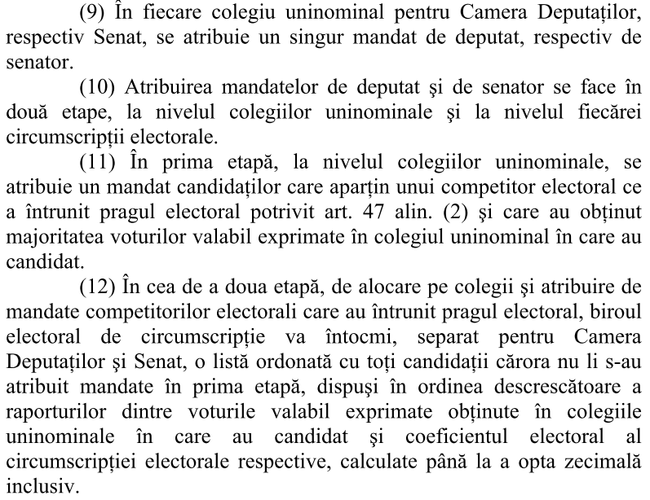
Mandates assignment
(step 1: Majority voting)
Dr. Horia F. Pop, Fuzzy Elections

Slide 13
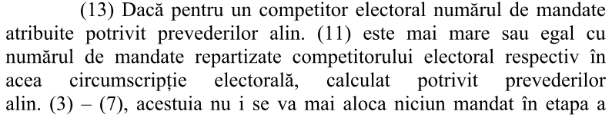
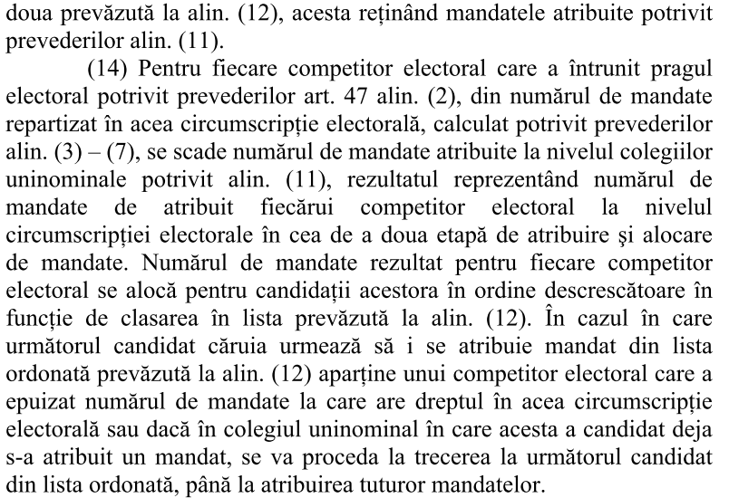
Mandates assignment
(step 2: Greedy)
Dr. Horia F. Pop, Fuzzy Elections

Slide 14
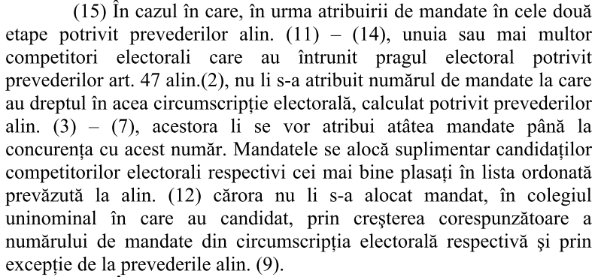
Multiple mandates per uninominal constituency (step 3)
Dr. Horia F. Pop, Fuzzy Elections

Slide 15
Synthetic algorithm
Seats allocation per party
Art 47(4). National electoral coefficient
  = number of national valid votes /
  / number of national uninominal colleges
Art 48(3). County electoral coefficient
  = number of county valid votes /
  / number of county uninominal colleges
Art. 48(4). Seats allocation per party, county (step 1)
  Nr seats = integer part of
  number of party county votes / county electoral coefficient

Slide 16
Synthetic algorithm
Seats allocation per party
Seats allocation per party nationally (step 2)
Art. 48(5). Total unused party votes = summed up nationally
Art. 48(6). All totals divided to 1, 2, 3, 4 …
  Number of divisions = number of national unallocated seats (k)
  Quotients sorted decreasingly; the k-th value selected = national electoral coefficient
  Parties get seats = integer part of unused party votes / coefficient

Slide 17
Synthetic algorithm
Seats allocation per party
Art. 48(7.a). National seats assigned per county
  Ratio: unused county party votes / total unused national party votes * nr of assigned national party seats
  These values sorted decreasingly at national, county levels
  For each county consider the largest values to the count of seats to be assigned; this value is called county repartitor
  Allocate seats using Greedy choice
    unused county party votes / county repartitor
Art. 48(7.c). Unallocated seats: by political choice or random selection

Slide 18
Synthetic algorithm
Individual seats assignment
Art. 48 (9-11). Step 1: majority voting wins a seat
Art. 48 (12-14). Step 2: Greedy choice assignment:
  Candidates sorted decreasingly by valid votes / county electoral coefficient
Art. 48 (15). Step 3: Multiple seats per constituency
  If not all allocated seats were assigned, continue as needed, by violating the uninominal principle

Slide 19
Results, Cluj county (2008)
Real results (votes)
Cluj | PDL | PSD | PNL | UDMR | Votes | Total
1 | 12,580 | 4,395 | 2,741 | 4,442 | 24,158 | 25,768
2 | 11,440 | 3,632 | 2,211 | 3,426 | 20,709 | 22,312
3 | 11,249 | 4,556 | 3,884 | 5,181 | 24,870 | 26,725
4 | 11,416 | 2,947 | 2,315 | 4,637 | 21,315 | 22,681
5 | 5,500 | 3,808 | 7,900 | 2,206 | 19,414 | 21,440
6 | 5,543 | 6,633 | 5,543 | 2,097 | 19,816 | 22,819
7 | 6,990 | 5,891 | 2,388 | 3,404 | 18,673 | 21,120
8 | 7,789 | 4,483 | 2,299 | 1,708 | 16,279 | 19,434
9 | 7,177 | 2,811 | 2,060 | 1,825 | 13,873 | 16,251
10 | 6,354 | 2,251 | 966 | 6,504 | 16,075 | 17,529
Total | 86,038 | 41,407 | 32,307 | 35,430 | 195,182 | 216,079
Relative | 4.408 | 2.121 | 1.655 | 1.815 | 10.000
Mandates | 4 | 2 | 2 | 2 | 10 | 21,607
Dr. Horia F. Pop, Fuzzy Elections

Slide 20
Results, Cluj county
Real results (percentage)
Cluj | PDL | PSD | PNL | UDMR | Votes
1 | 0.488 | 0.171 | 0.106 | 0.172 | 0.938
2 | 0.513 | 0.163 | 0.099 | 0.154 | 0.928
3 | 0.421 | 0.170 | 0.145 | 0.194 | 0.931
4 | 0.503 | 0.130 | 0.102 | 0.204 | 0.940
5 | 0.257 | 0.178 | 0.368 | 0.103 | 0.906
6 | 0.243 | 0.291 | 0.243 | 0.092 | 0.868
7 | 0.331 | 0.279 | 0.113 | 0.161 | 0.884
8 | 0.401 | 0.231 | 0.118 | 0.088 | 0.838
9 | 0.442 | 0.173 | 0.127 | 0.112 | 0.854
10 | 0.362 | 0.128 | 0.055 | 0.371 | 0.917
Total | 3.960 | 1.913 | 1.477 | 1.651 | 9.002
Mandates | 4 | 2 | 2 | 2 | 10
Dr. Horia F. Pop, Fuzzy Elections

Slide 21
Results, Cluj county
Real results (scaled percentages)
Cluj | PDL | PSD | PNL | UDMR | Total
1 | 0.521 | 0.182 | 0.113 | 0.184 | 1.000
2 | 0.552 | 0.175 | 0.107 | 0.165 | 1.000
3 | 0.452 | 0.183 | 0.156 | 0.208 | 1.000
4 | 0.536 | 0.138 | 0.109 | 0.218 | 1.000
5 | 0.283 | 0.196 | 0.407 | 0.114 | 1.000
6 | 0.280 | 0.335 | 0.280 | 0.106 | 1.000
7 | 0.374 | 0.315 | 0.128 | 0.182 | 1.000
8 | 0.478 | 0.275 | 0.141 | 0.105 | 1.000
9 | 0.517 | 0.203 | 0.148 | 0.132 | 1.000
10 | 0.395 | 0.140 | 0.060 | 0.405 | 1.000
Total | 4.389 | 2.143 | 1.649 | 1.818 | 10.000
Mandates | 4 | 2 | 2 | 2 | 10
Dr. Horia F. Pop, Fuzzy Elections

Slide 22
Greedy algorithm
The Greedy property / optimal substructure
  The best next move always leads to the optimal solution
Simple, but not always effective
Example: the coins change problem
Problem is parametrized
  Coins face value
  Depending on these, Greedy works or not
  Examples:
    Coins value is 1, 2, 5
    Coins value is 1, 4, 5
Dr. Horia F. Pop, Fuzzy Elections

Slide 23
Example (case study):
6 constituencies and 9 mandates
2 counties same data | C1 | C2 | C3 | Total | remainder | total
P1 | 510 | 508 | 506 | 1524 | 524 | 1048
P2 | 280 | 281 | 282 | 843 | 843 | 1686
P3 | 210 | 211 | 212 | 633 | 633 | 1266
Total | 1000 | 1000 | 1000 | 3000 | 3000/3=1000
Dr. Horia F. Pop, Fuzzy Elections

Slide 24
(continued)
Mandates allocation, step 1
P1 = 1 | P1 = 1
P2 = 0 | P2 = 0
P3 = 0 | P3 = 0
non-allocated = 4 mandates
P1 | 1048 | 524 | 349.33 | 262
P2 | 1686 | 843 | 562 | 421.50
P3 | 1266 | 633 | 422 | 316.50
1686, 1266, 1048, 843
Dr. Horia F. Pop, Fuzzy Elections

Slide 25
(continued)
Mandates allocation, step 2
P1 = 1 = [1048/843]
P2 = 2 = [1686/843]
P3 = 1 = [1266/843]
Total mandates per country
P1 = 2 + 1 = 3
P2 = 0 + 2 = 2
P3 = 0 + 1 = 1
Dr. Horia F. Pop, Fuzzy Elections

Slide 26
(continued)
Mandates allocation, step 3
 | C1 |  | C2 |  | C1 | C2
P1 | 524/1048*1 = 0.5 |  | 524/1048*1 = 0.5 |  |  | (2) gets 1
P2 | 843/1686*2=1 |  | 843/1686*2=1 |  | (1) gets 2
P3 | 633/1266*1=0.5 |  | 633/1266*1=0.5 |  |  | (3) gets 1
repartitor | 0.5 |  | 0.5
 | C1 | C2
P1 | 1+0 | 1+1
P2 | 0+2 | 0+0
P3 | 0+0 | 0+1
Dr. Horia F. Pop, Fuzzy Elections

Slide 27
(continued)
Mandates assignment, step 1
510 | 508 | 506 |  | 510 | 508 | 506
280 | 281 | 282 |  | 280 | 281 | 282
210 | 211 | 212 |  | 210 | 211 | 212
Mandates assignment, step 3
510 | 508 | 506 |  | 510 | 508 | 506
280 | 281 | 282 |  | 280 | 281 | 282
210 | 211 | 212 |  | 210 | 211 | 212
Dr. Horia F. Pop, Fuzzy Elections

Slide 28
Results, Cluj county (again)
(fuzzy partition)
Real results (scaled percentages)
Cluj | PDL | PSD | PNL | UDMR | Total
1 | 0.521 | 0.182 | 0.113 | 0.184 | 1.000
2 | 0.552 | 0.175 | 0.107 | 0.165 | 1.000
3 | 0.452 | 0.183 | 0.156 | 0.208 | 1.000
4 | 0.536 | 0.138 | 0.109 | 0.218 | 1.000
5 | 0.283 | 0.196 | 0.407 | 0.114 | 1.000
6 | 0.280 | 0.335 | 0.280 | 0.106 | 1.000
7 | 0.374 | 0.315 | 0.128 | 0.182 | 1.000
8 | 0.478 | 0.275 | 0.141 | 0.105 | 1.000
9 | 0.517 | 0.203 | 0.148 | 0.132 | 1.000
10 | 0.395 | 0.140 | 0.060 | 0.405 | 1.000
Total | 4.389 | 2.143 | 1.649 | 1.818 | 10.000
Mandates | 4 | 2 | 2 | 2 | 10
Dr. Horia F. Pop, Fuzzy Elections

Slide 29
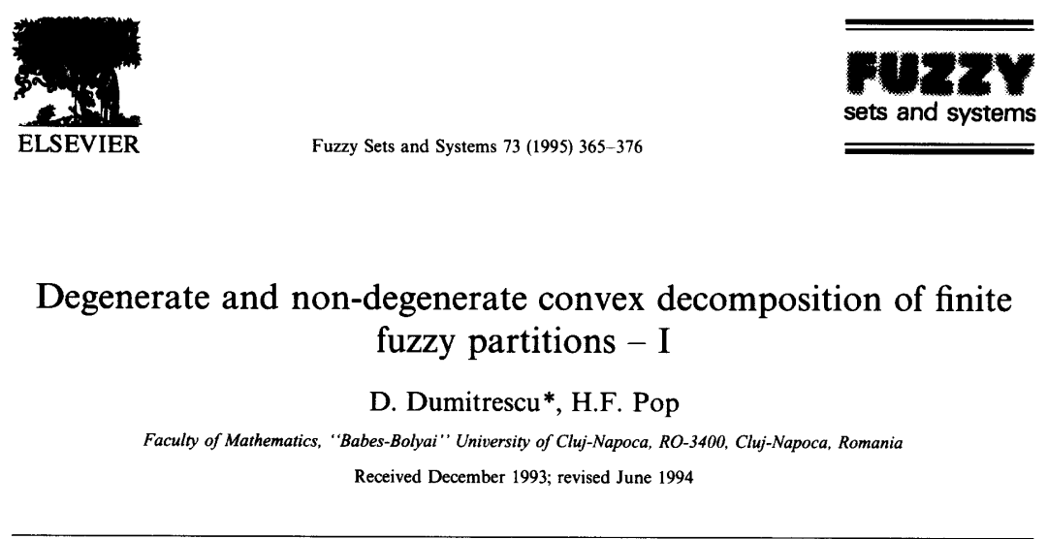
Fuzzy and Crisp Partitions
Dr. Horia F. Pop, Fuzzy Elections

Slide 30
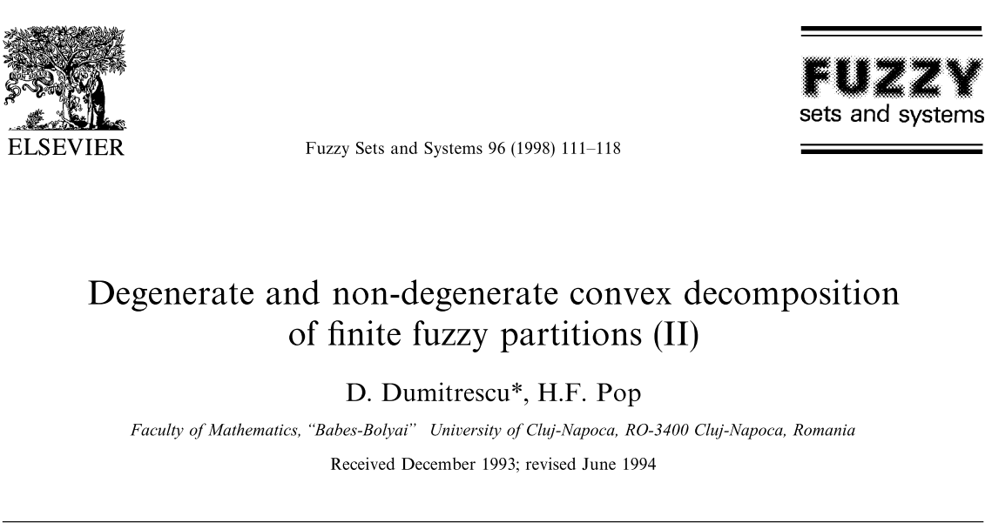
Fuzzy and Crisp Partitions
Dr. Horia F. Pop, Fuzzy Elections

Slide 31




Partitions spaces
Non-degenerate hard partitions
Degenerate hard-partitions
Non-degenerate fuzzy partitions
Degenerate fuzzy partitions
Dr. Horia F. Pop, Fuzzy Elections

Slide 32
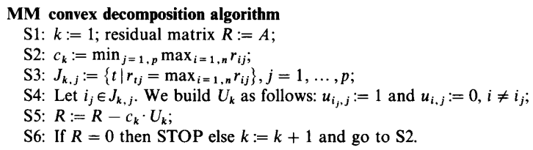
MiniMax decomposition algorithm
Dr. Horia F. Pop, Fuzzy Elections

Slide 33
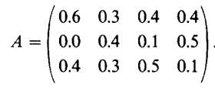
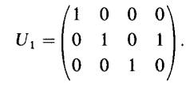
Example
Fuzzy cardinals
  1.7
  1.0
  1.2
Crisp cardinals
  1
  2
  1
Dr. Horia F. Pop, Fuzzy Elections

Slide 34
Counterexample
Divisive Hierarchical Clustering
P = {A₁, A₂₁, A₂₂}
  A₁(x) = 0.45
  A₂₁(x) = 0.30
  A₂₂(x) = 0.25
So, x ∈ A₂₁, and not x ∈ A₁
  Why?
Dr. Horia F. Pop, Fuzzy Elections

Slide 35
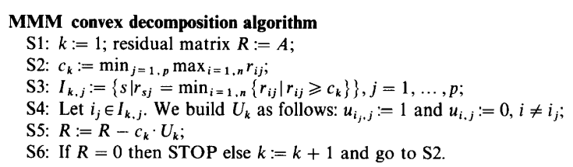
MiniMiniMax decomposition
Dr. Horia F. Pop, Fuzzy Elections

Slide 36
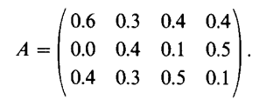
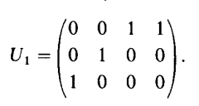
Example
Fuzzy cardinals
  1.7
  1.0
  1.2
Crisp cardinals
  2
  1
  1
Dr. Horia F. Pop, Fuzzy Elections

Slide 37
MM vs MMM - Results
MM and MMM stop after a finite number of steps
Any fuzzy partition may be decomposed in convex combination of degenerate crisp partitions
All convex decompositions of a fuzzy partition by MM/MMM have the same length
The coefficients sequence using MM/MMM is strictly decreasing
Dr. Horia F. Pop, Fuzzy Elections

Slide 38
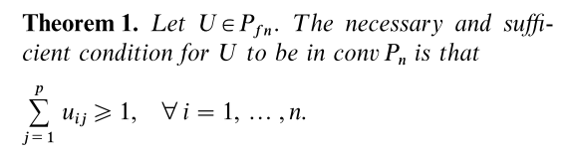
Third method:
(non)degenerate decomposition
Dr. Horia F. Pop, Fuzzy Elections

Slide 39
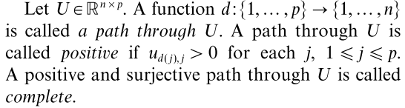
Notations
Dr. Horia F. Pop, Fuzzy Elections

Slide 40
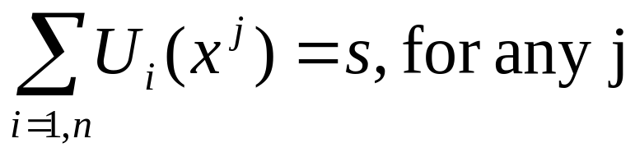
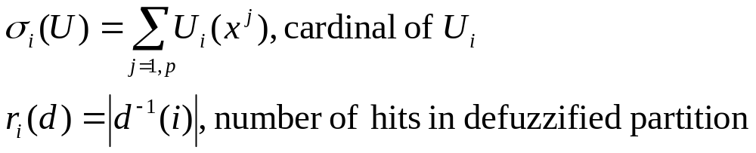
More notations
Let s in (0,1]. Consider matrix U in [0,1]^{nxp} with property that
Dr. Horia F. Pop, Fuzzy Elections

Slide 41
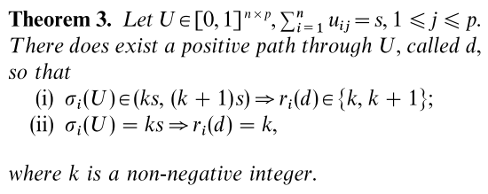
Essential theorem
Dr. Horia F. Pop, Fuzzy Elections

Slide 42
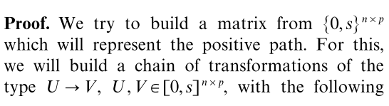
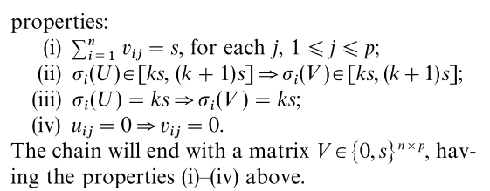
Hint of proof (constructive)
Dr. Horia F. Pop, Fuzzy Elections

Slide 43
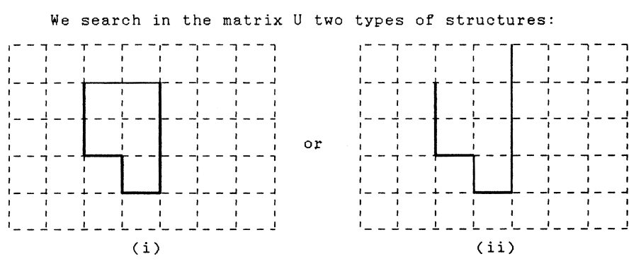
How to construct new matrix
Dr. Horia F. Pop, Fuzzy Elections

Slide 44
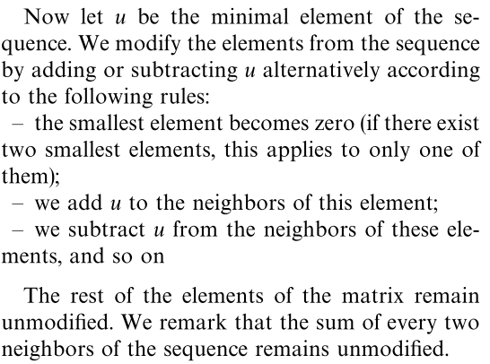
(continued)
Dr. Horia F. Pop, Fuzzy Elections

Slide 45
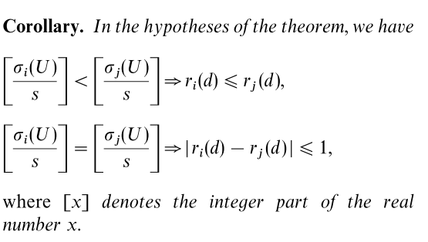
Corollary
Dr. Horia F. Pop, Fuzzy Elections

Slide 46
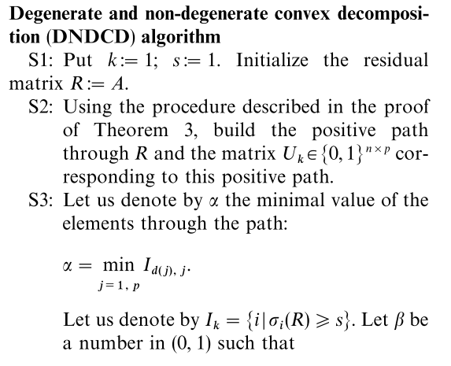
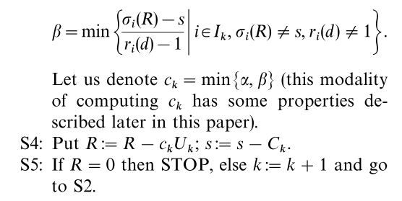
DNDCD
Algorithm
Dr. Horia F. Pop, Fuzzy Elections

Slide 47
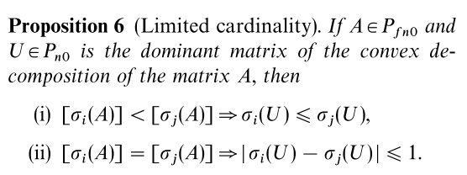
Limited cardinality
Dr. Horia F. Pop, Fuzzy Elections

Slide 48
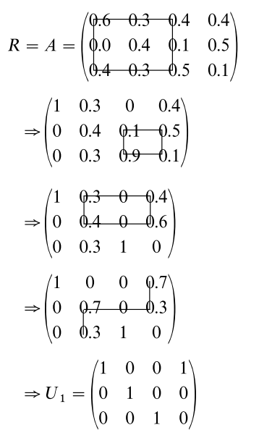
Example
Fuzzy cardinals
  1.7
  1.0
  1.2
Crisp cardinals
  2
  1
  1
Dr. Horia F. Pop, Fuzzy Elections

Slide 49
Example (case study)
0.500010 0.500010 0.500010
0.290030 0.290020 0.290010
0.209960 0.209970 0.209980
0.500010 0.500010 0.500010
0.290030 0.499990 0.080040
0.209960 0.000000 0.419950
0.500010 0.419970 0.580050
0.290030 0.580030 0.000000
0.209960 0.000000 0.419950
0.709970 0.419970 0.370090
0.290030 0.580030 0.000000
0.000000 0.000000 0.629910
1.000000 0.129940 0.370090
0.000000 0.870060 0.000000
0.000000 0.000000 0.629910
1.000000 0.129940 0.370090
0.000000 0.870060 0.000000
0.000000 0.000000 0.629910
1.000000 0.000000 0.500030
0.000000 1.000000 0.000000
0.000000 0.000000 0.499970
1.000000 0.000000 1.000000
0.000000 1.000000 0.000000
0.000000 0.000000 0.000000
Dr. Horia F. Pop, Fuzzy Elections

Slide 50
Example (case study)
0.000000 0.500010 0.790050 1.000000 0.339910 0.370090
0.790070 0.290050 0.000000 0.000000 0.660090 0.000000
0.209930 0.209940 0.209950 0.000000 0.000000 0.629910
0.000000 0.500010 0.790050 1.000000 0.339910 0.370090
1.000000 0.080120 0.000000 0.000000 0.660090 0.000000
0.000000 0.419870 0.209950 0.000000 0.000000 0.629910
0.000000 0.290060 1.000000 1.000000 0.339910 0.370090
1.000000 0.080120 0.000000 0.000000 0.660090 0.000000
0.000000 0.629820 0.000000 0.000000 0.000000 0.629910
0.000000 0.000000 1.000000 1.000000 0.339910 0.660150
1.000000 0.080120 0.000000 0.000000 0.660090 0.000000
0.000000 0.919880 0.000000 0.000000 0.000000 0.339850
0.000000 0.000000 1.000000 1.000000 0.259790 0.660150
1.000000 0.000000 0.000000 0.000000 0.740210 0.000000
0.000000 1.000000 0.000000 0.000000 0.000000 0.339850
0.000000 0.000000 1.000000 1.000000 0.000000 0.919940
1.000000 0.000000 0.000000 0.000000 1.000000 0.000000
0.000000 1.000000 0.000000 0.000000 0.000000 0.080060
0.000000 0.000000 1.000000 1.000000 0.000000 1.000000
1.000000 0.000000 0.000000 0.000000 1.000000 0.000000
0.000000 1.000000 0.000000 0.000000 0.000000 0.000000
0.500010 0.500010 0.500010 0.500010 0.500010 0.500010
0.290060 0.290050 0.290040 0.290030 0.290020 0.290010
0.209930 0.209940 0.209950 0.209960 0.209970 0.209980
0.500010 0.500010 0.500010 0.500010 0.500010 0.500010
0.290060 0.290050 0.290040 0.290030 0.499990 0.080040
0.209930 0.209940 0.209950 0.209960 0.000000 0.419950
0.500010 0.500010 0.500010 0.500010 0.419970 0.580050
0.290060 0.290050 0.290040 0.290030 0.580030 0.000000
0.209930 0.209940 0.209950 0.209960 0.000000 0.419950
0.209980 0.500010 0.500010 0.790040 0.419970 0.580050
0.580090 0.290050 0.290040 0.000000 0.580030 0.000000
0.209930 0.209940 0.209950 0.209960 0.000000 0.419950
0.209980 0.500010 0.500010 1.000000 0.419970 0.370090
0.580090 0.290050 0.290040 0.000000 0.580030 0.000000
0.209930 0.209940 0.209950 0.000000 0.000000 0.629910
0.000000 0.500010 0.500010 1.000000 0.629950 0.370090
0.790070 0.290050 0.290040 0.000000 0.370050 0.000000
0.209930 0.209940 0.209950 0.000000 0.000000 0.629910
Dr. Horia F. Pop, Fuzzy Elections

Slide 51
Example (Cluj county)
0.520738 0.552417 0.452312 0.535585 0.283301 0.279723 0.374337 0.478469 0.517336 0.395272
0.181927 0.175383 0.183193 0.138259 0.196147 0.334730 0.315482 0.275385 0.202624 0.140031
0.113461 0.106765 0.156172 0.108609 0.406923 0.279723 0.127885 0.141225 0.148490 0.060093
0.183873 0.165435 0.208323 0.217546 0.113629 0.105824 0.182295 0.104920 0.131550 0.404603
= 4.389491
= 2.143161
= 1.649347
= 1.818001
1 1 0 1 0 0 0 1 1 0 = 5 2.604546 1 1 1 1 0 0 0 0 1 0 = 5 2.578388
0 0 0 0 0 1 1 0 0 0 = 2 0.650212 0 0 0 0 0 1 1 1 0 0 = 3 0.925597
0 0 0 0 1 0 0 0 0 0 = 1 0.406923 0 0 0 0 1 0 0 0 0 0 = 1 0.406923
0 0 1 0 0 0 0 0 0 1 = 2 0.612927 0 0 0 0 0 0 0 0 0 1 = 1 0.404603
4.274607 4.315512
Dr. Horia F. Pop, Fuzzy Elections

Slide 52
Remarks & Conclusions
Method not leading to unique results
  Limited cardinality property is guaranteed
How to select the best solution?
Answer is problem dependent
For elections:
  Total vote percentage of selected mandates should be maximal at national (not county) level
To follow:
  A nice topic for an M.Sc. disertation (to start with)
Dr. Horia F. Pop, Fuzzy Elections

